Slide 1
Pushing IDS to Network
Ryan Becker

Slide 2
Methods to act as Network IDS
Managed Switch
Network Tap
Software feature called SPAN port to copy traffic to a designated port to monitor
Passive hardware device that creates a perfect, full copy of all network traffic for monitoring

Slide 3
What is a managed network switch?
VLAN Creation
Manage Traffic
Monitoring
Creates a virtual local area network within your router's broadcasted network
Ability to block and reroute packets to specific ports
Ability to connect a device into the switch and you are able to tcpdump all the traffic of ethernet connections to the switch

Slide 4
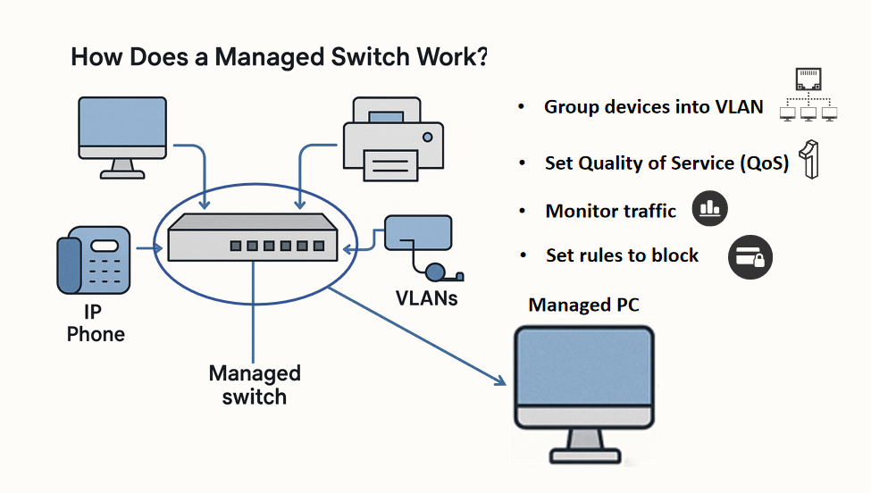

Slide 5
What is a network tap?
Deployment
Monitoring
More Reliable
Sits between two devices to capture all traffic ex: may sit between a router and managed switch
Passively copies traffic and creates full line rate traffic
Less lost packets, more accurate and usually passive

Slide 6
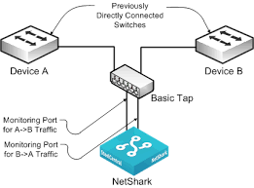

Slide 7
Hyper-V
What is Hyper-V?
Hyper-V is a virtualization platform that includes the Hyper-V Virtual Switch Virtual Switch is a programmable level 2 network switch connecting virtual and physical devices
Restrictions
Can download the install files to computer, but requires Windows Pro or Enterprise license to create VLAN

Slide 8

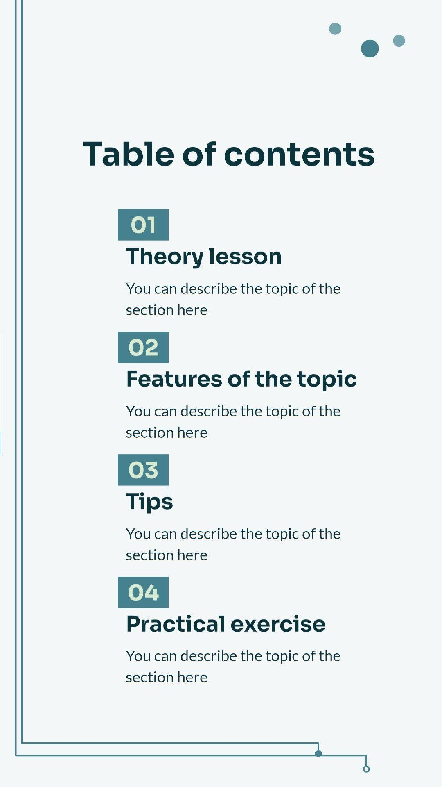
Negative news
Concluded, could not use hyper v and no free way to configure Suricata or IDS to act as a fully network IDS.
I heard the goodwill up the street sometimes has network switches and sundays they have a student discount so may explore further after obtaining that.

Slide 9
How can I successfully convert a raspberry pi 4 to mimic a network tap between router and AP, while raspberry 5 acts as AP?

Slide 10
Interfaces that will be used
01
02
03
04
Tap Interface
Allows users to create a tunnels between devices
Bridge Interface
Combine multiple interfaces into a single Layer 2 network
Ethernet Interface
Allows a device to be connected to a wired network
Wireless LAN Interface
Allows a device to be connected to with wifi

Slide 11
Raspberry PI 5 Interface Setup
WLAN1
AP does not assign IPs, rather gets them from the Router via the tunnel
PI 5
Br0
Layer2 Bridge between AP and VPN. Obtains static IP for management
Tap0
Venus has a very beautiful name and is the second planet from the Sun

Slide 12
Raspberry PI 4 Interface Setup
wlan0
Connects to the PI 5 AP on a dedicated tunnel network ex: 192.168.100.XXX
PI 4
Eth0
Apart of the Router bridge
Br0
Bridge between eth0 and tap0. Main IP from the Router’s DHCP

Slide 13
Flow of Data
DHCP on Wlan1
PI 5 Br0
Pi 5 tap0
DHCP request received by pi 5 on WLAN1
Passes request into br0 interface
Then passes into encrypted OpenVpn tunnel
Wifi Link
Travels from pi 5 WLAN1 to pi 4 WLAN0
Pi 4 Tap0
Pi 4 Br0
Eth0 to Router
Decrypted and exits Pi 4 tap0
Passes into Pi 4 br0
Exits Pi 4 eth0 to the Router (response is reversed)

